Slide 1
Status of the seed project and a plan for developing the collaboration projects under KUTC
Daniel Choi, Jeremie Pelletier
July 6, 2020
Khalifa University of Science and Technology
1

Slide 2
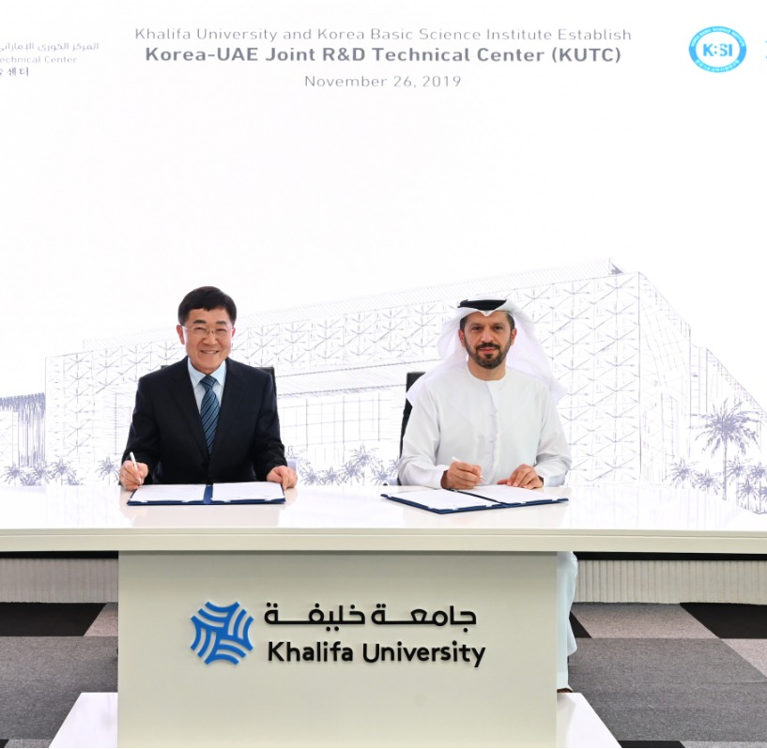
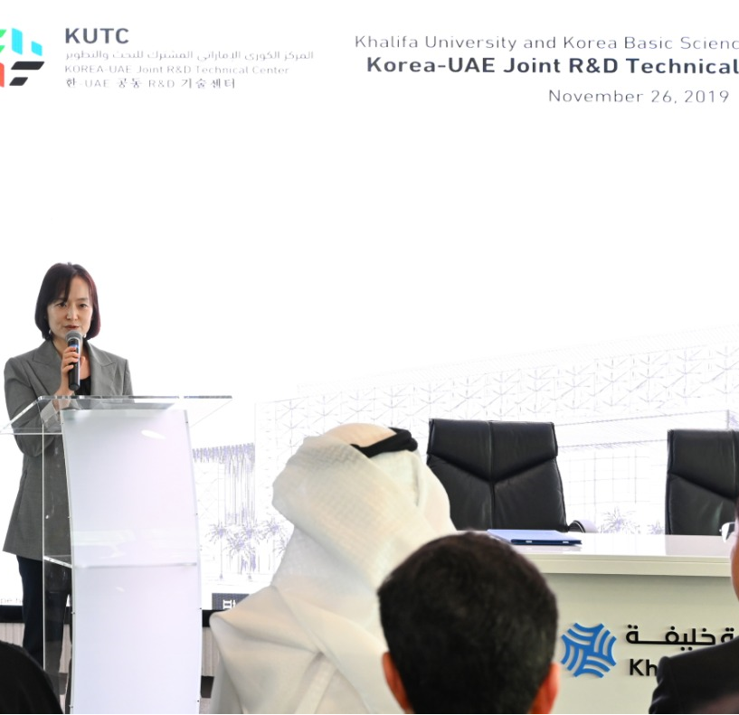
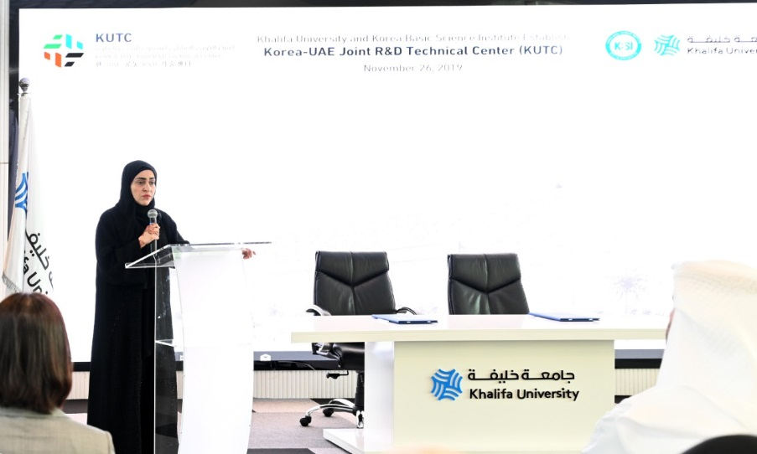
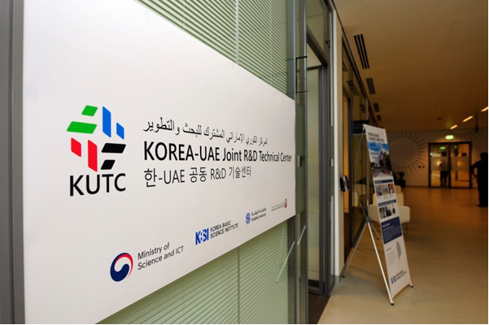
Launched KUTC on Nov. 26, 2019!
Korea Ministry of Science’s
congrats remarks
Abu Dhabi DED’s congrats remarks
Signing by the leaderships
(KU and KBSI)
4

Slide 3
First Seed Project Under KUTC (kicked off on 26th November 2019)
Development of solid electrolytes for harsh environment batteries
KBSI PI: Dr. Hae Jin Kim
KU PI: Dr. Daniel Choi
KU Staff (Planned/status) | KBSI (Planned/status) | Meeting frequencies | Publications | IP | Team’s visit to counterpart | Proposal submitted
1 Postdoc/1 Postdoc | 2 research staffs | 3 (1 phone meeting, 1 video-call) + multiple e-mail exchanges | 1 Review paper is in preparation (KU) | 0 | 2 KBSI staffs’ visit to KU (1 month) | 1 Joint proposal (in preparation)
Target:
Solid electrolytes with carbon nanocomposites
No internal heating at low temperature
Low cost process
Reduced weight
2

Slide 4
Development of the Joint Projects: Directed Call for Proposals
Competitive award
Focused areas: Energy, oil & gas/catalysts, health, semiconductor devices and characterization, and more
Bottom-up formation of teams
Task plan based on complementary work
$100K/year/project (PI of each institute) for 3 years (Next round to be kicked off in January 2021)
Option: Linked to NST’s Global Joint Research Program
3

Slide 5
Time table for project development
Aug 2020
Sept
Oct
Nov
Dec
Jan 2021
Submission of white papers
by KU faculty
identifying KBSI focused area lead
Submission of full proposals
Jointly
Selection of the projects by proposal selection committee
(KUTC directors, KU center directors, KBSI management)
Identify KBSI focused area leads & prepare focused area descriptions
Announce
call for white papers
Kick off the awarded projects
Invite to write full proposals by selection committee
(KUTC directors,
KU center directors, KBSI focused area leads)
4

Slide 6
Challenges currently faced by the center
Short term of KBSI visiting scientist’s residency at KU (Difficulty in visiting scientist’s own research progress during residency at KU)
Reviewing/evaluation of the progress in KUTC’s activities
Lacking in collaboration with other research centers
Lacking in visibility of the center
5

Slide 7
Strategic planning in order to bring KUTC to the next level of development
Identifying more stakeholders from UAE side (government and industry sectors) to secure the co-funding in order to extend research focused areas into energy, catalysts, health, oil & gas, semiconductors, etc.
Building up advisory board by inviting top management from potential stakeholders nationally.
Acquiring physical space within campus for improving visibility of the center and effective interaction with other research centers
Acknowledging KUTC on the publications upon KUTC staff’s engagement
Developing strategic plans for near term (1-2 years) and long-term (5 years)
6

Slide 8
Thank You
7

